Slide 1
Introduction to Convolutional Neural Networks with Tensorflow
Week 10, Day 3

Slide 2

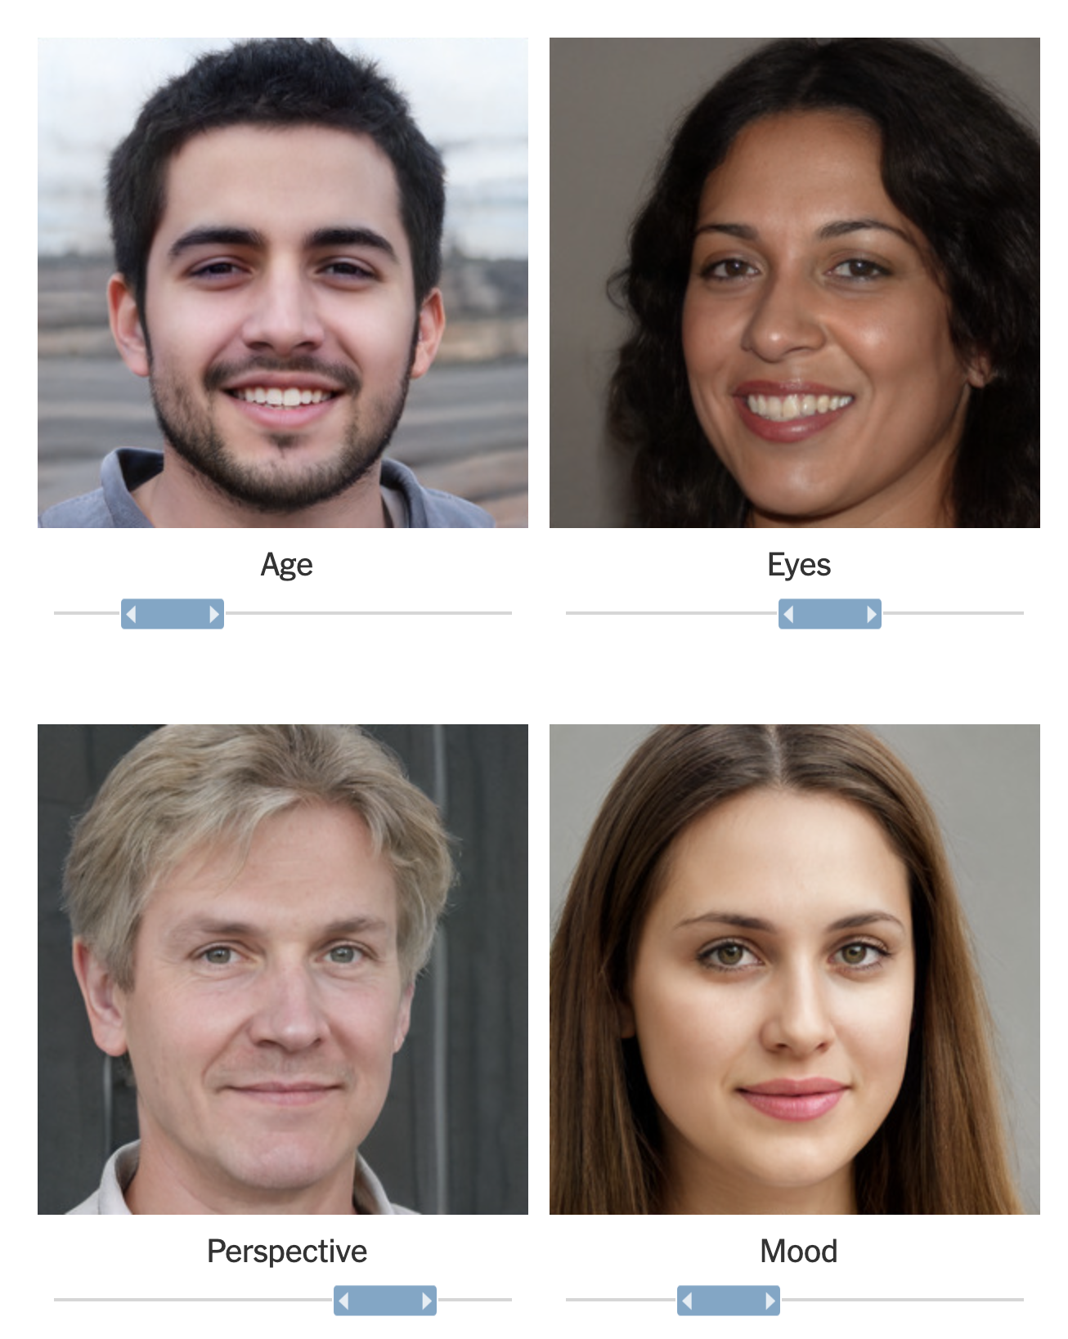
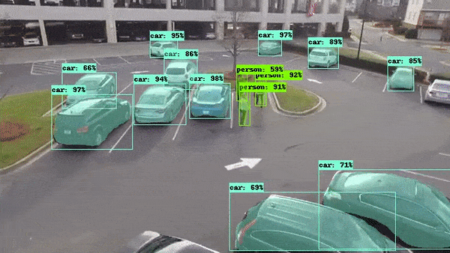
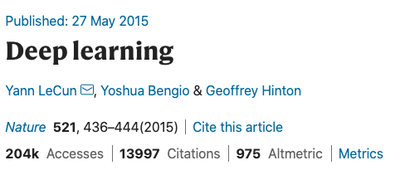
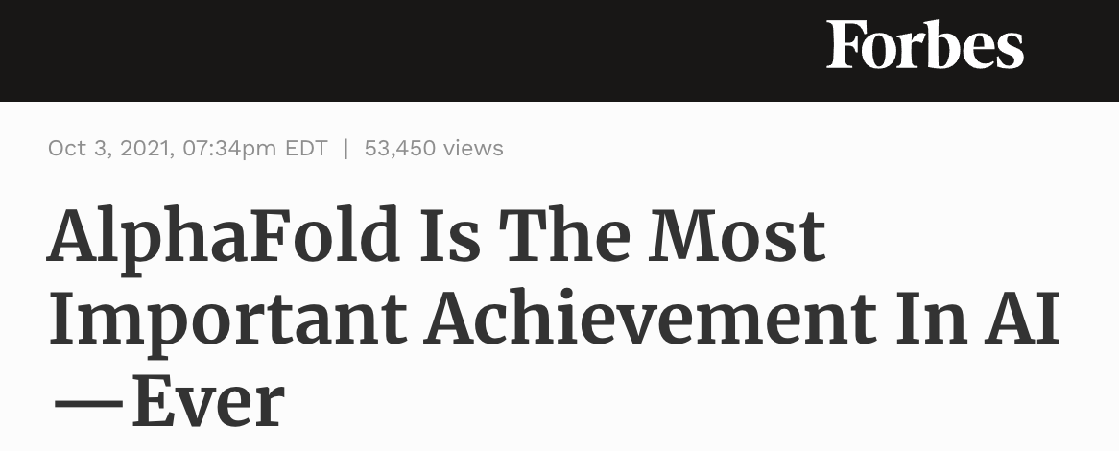
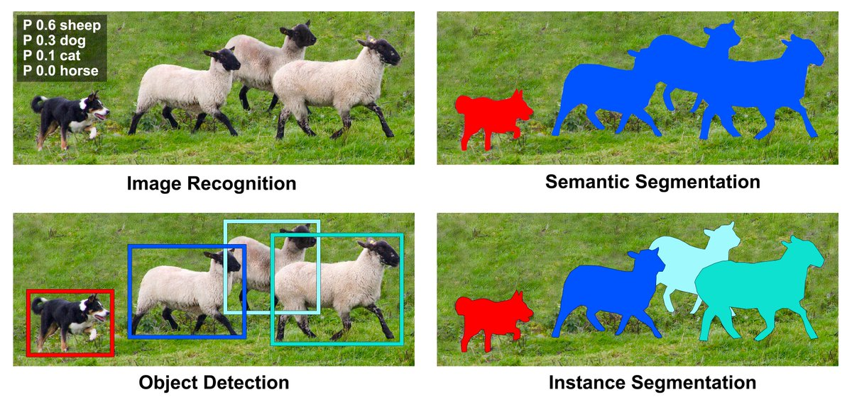

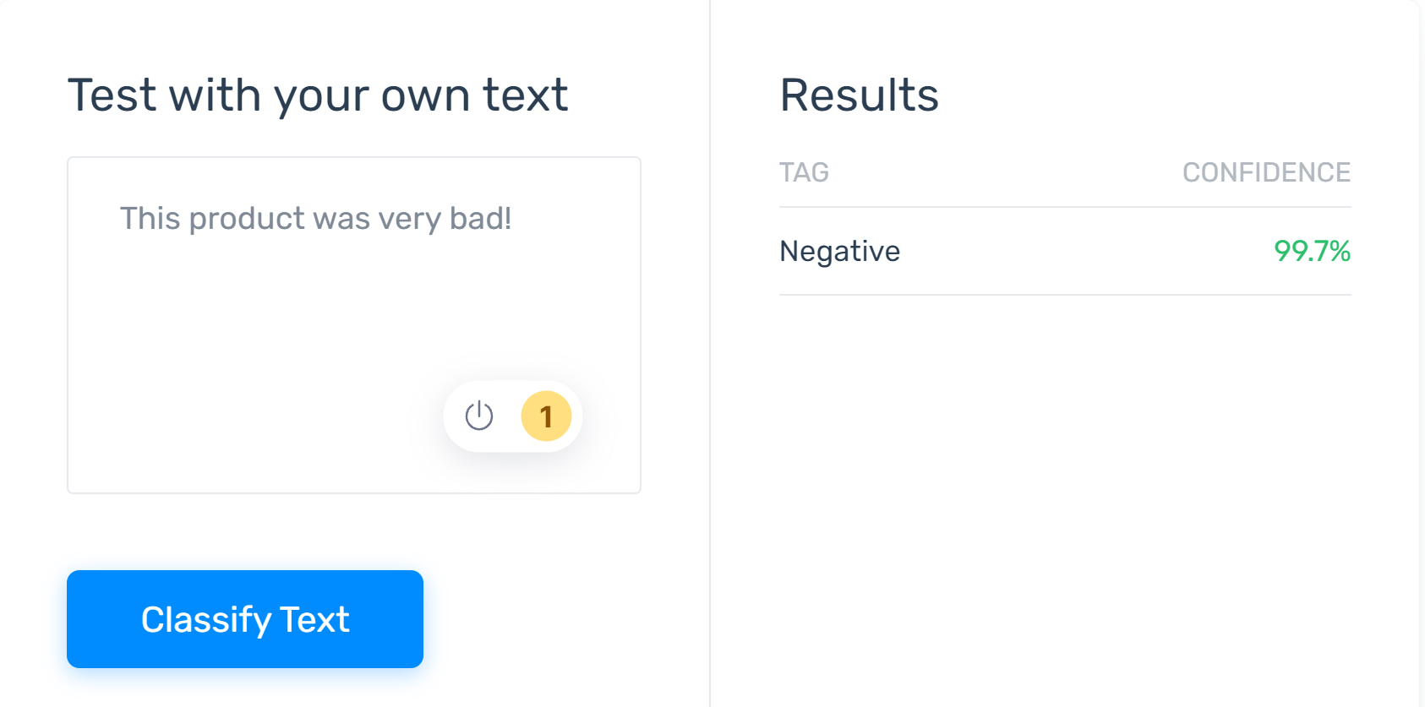

Deepfake Generation: Forbes Article
https://www.forbes.com/sites/robtoews/2021/10/03/alphafold-is-the-most-important-achievement-in-ai-ever/
37% of tech organizations use AI!
Sentiment Analysis of reviews.

Slide 3
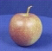
The machine learning framework
y = h(x)
Training: given a training set of labeled examples {(x₁,y₁), …, (x_{N},y_{N})}, estimate the prediction function h by minimizing the prediction error on the training set
Testing: apply h to a never before seen test example x and output the predicted value y = h(x)
h(. ) = “apple”
output
prediction function
Image feature

Slide 4
Deep Learning Pipeline
Step 1
Step 2
Step 3
Step 4
Step 5
Step 6
Load and Preprocess Data
Data Visualization
Design the Deep Learning Model
Train the Model
Define
Evaluate the Model
Save the Trained Model
We can reuse the model (to train) at a later date without training the model again
We can do evaluation or Inference on the trained model without training again
Save the parameters of the model and pass it to another team
Researcher A trains the model and passes it on to researcher B who is in charge of evaluation.

Slide 5
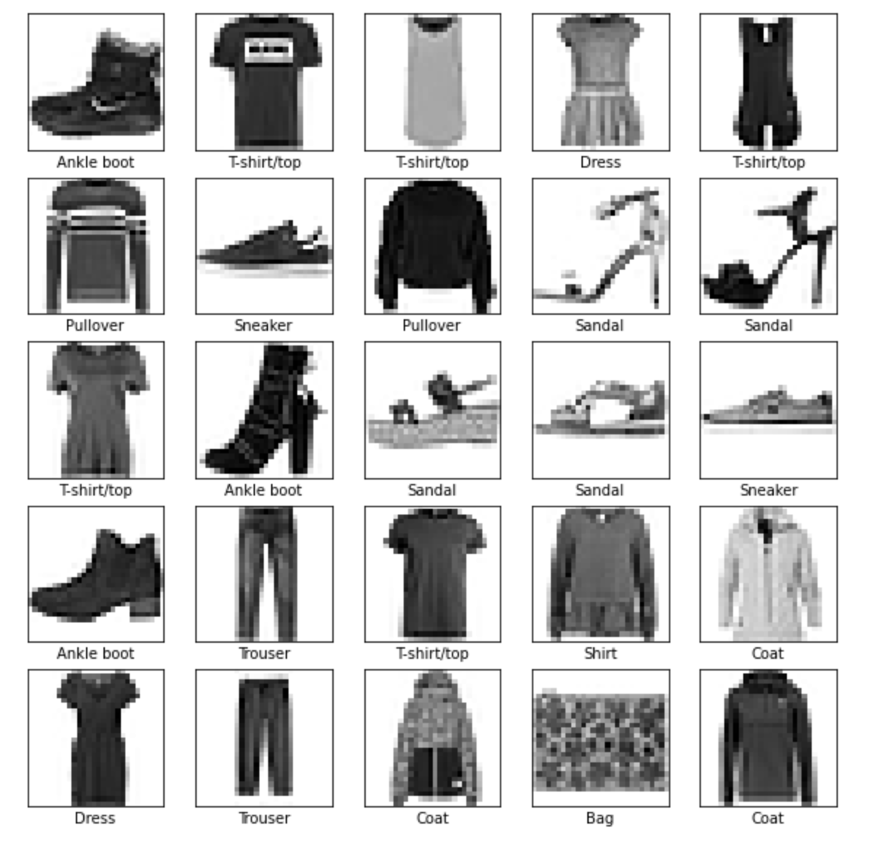
Agenda
For this exercise, we will use Fashion MNIST dataset to classify the clothing in an image. We will follow the 6-step pipeline to design our convolutional neural network.

Slide 6
Step 1: Load and Preprocess the Data
Task 1: Download/fetch the dataset.
Task 2: Split the dataset to training and testing datasets.
Task 3: Normalize and preprocess the datasets.
# task 1: download/fetch the dataset
fashion_mnist = tf.keras.datasets.fashion_mnist
# task 2: split the dataset to training and testing datasets (train_images, train_labels), (test_images, test_labels) = fashion_mnist.load_data()
# task 3: normalize and preprocess the datasets.
train_images = train_images / 255.0 test_images = test_images / 255.0
train_images = train_images.reshape(-1, 28, 28, 1)
test_images = test_images.reshape(-1, 28, 28, 1)

Slide 7
Step 1, Task 2: Training and Testing Data Splits for Generalization of the Model
Training Labels
How well does a learned model generalize from the data it was trained on to a new test set?
Generalization refers to your model's ability to make correct predictions on new, previously unseen data as opposed to the data used to train the model.
Training Data
h
Training
Learned model
Testing Data
h
Learned model
Prediction

Slide 8
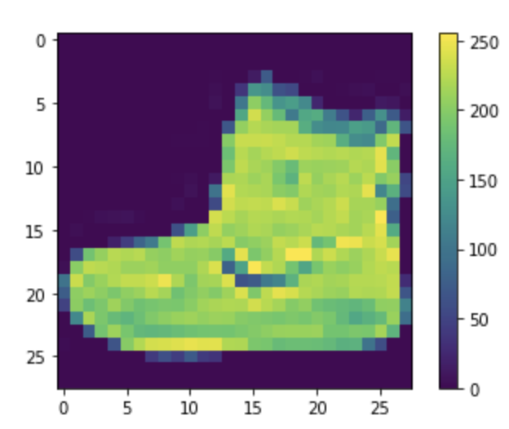
Step 2: Data Visualization
It is important to visualize some samples from the dataset. This allows us to verify the data as well as visually inspect the differences between different classes in the dataset.
plt.figure() plt.imshow(train_images[0]) plt.colorbar() plt.grid(False) plt.show()

Slide 9
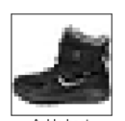
Step 3: Design the Deep Learning Model
model = tf.keras.Sequential([
# Conv 2D, MaxPool, with optional Dropout
tf.keras.layers.Conv2D(filters=64, kernel_size=2,
padding='same', activation='relu', input_shape=(28,28,1)),
tf.keras.layers.MaxPooling2D(pool_size=2),
tf.keras.layers.Dropout(0.3),
# Conv 2D, MaxPool, with optional Dropout
tf.keras.layers.Conv2D(filters=32, kernel_size=2,
padding='same', activation='relu'),
tf.keras.layers.MaxPooling2D(pool_size=2),
tf.keras.layers.Dropout(0.3),
# Flatten the layer to feed to Dense layer
tf.keras.layers.Flatten(),
# Final Dense layers for classification
tf.keras.layers.Dense(256, activation='relu'),
tf.keras.layers.Dropout(0.5),
# Converting to probability domain using Softmax
tf.keras.layers.Dense(10, activation='softmax')
])
Convolution 2D
MaxPooling
Convolution 2D
MaxPooling
Hidden Layer
Softmax
28
Ankle Boot
28
10
256

Slide 10
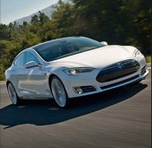

Fully Connected Feedforward network
Convolution
Max Pooling
Convolution
Max Pooling
car
Flattened
A new image
A new image

Slide 11
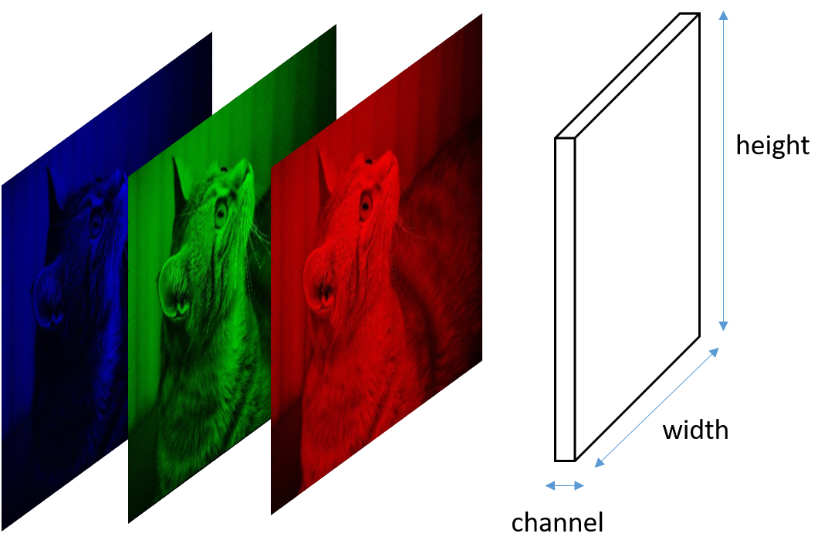
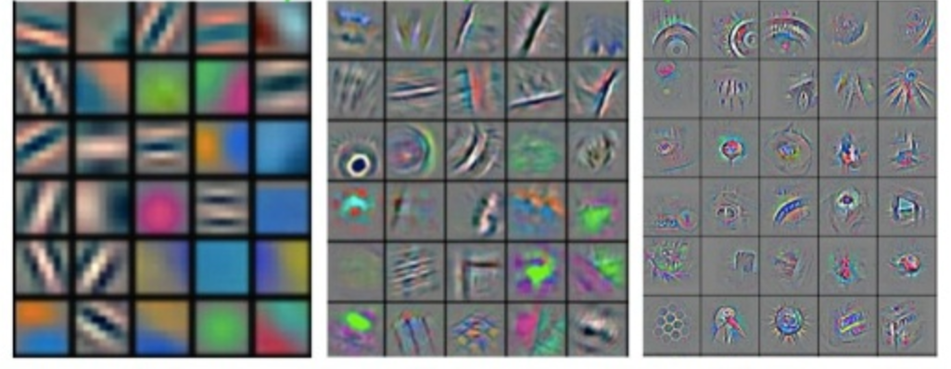

Conv Layer 1
Conv Layer 2
Conv Layer 3
CAT
Low-level features
Mid-level features
High-level features
https://www.analyticsvidhya.com/blog/2021/05/20-questions-to-test-your-skills-on-cnn-convolutional-neural-networks/

Slide 12
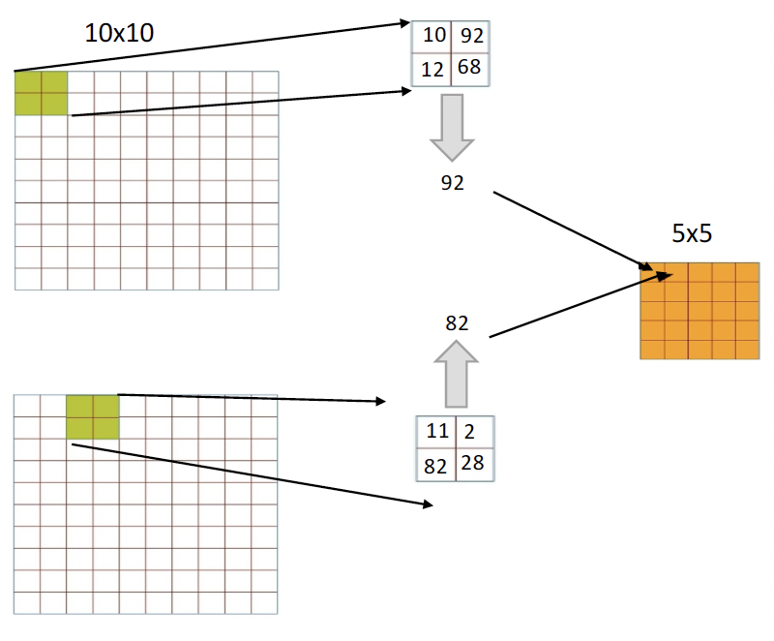
Pooling
Pooling operation reduces the dimensionality of each feature map by retaining the most important information present in them. There are different types of Pooling operation available, including Max Pooling, Average Pooling, etc. It is applied after convolution and RELU operations. By doing so, we reduce the size of the output feature maps considerably, thereby reducing the computational requirements for training the CNNs.
Example of Max Pooling.

Slide 13
Step 4: Train the Deep Learning Model
model.compile(optimizer='adam’,
loss=tf.keras.losses.SparseCategoricalCrossentropy(from_logits=False),
metrics=['accuracy’])
model.fit(train_images, train_labels, epochs=10)

Slide 14
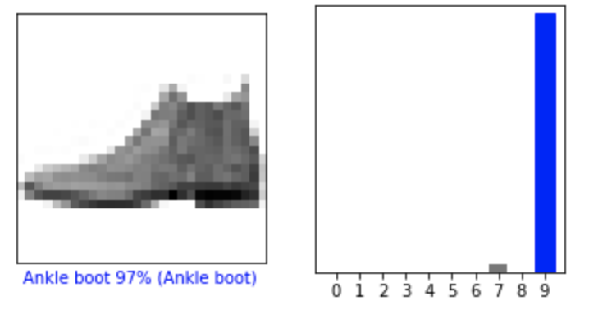
Step 5: Evaluate the Model
test_loss, test_acc = model.evaluate(test_images, test_labels, verbose=2)
print('\nTest accuracy:', test_acc)
i = 0
plt.figure(figsize=(6,3))
plt.subplot(1,2,1)
plot_image(i, predictions[i], test_labels, test_images.reshape(-1, 28,28))
plt.subplot(1,2,2)
plot_value_array(i, predictions[i], test_labels)
plt.show()

Slide 15
Step 6: Save the Model
https://www.tensorflow.org/tutorials/keras/save_and_load
Convolution 2D
MaxPooling
Convolution 2D
MaxPooling
Hidden Layer
Softmax
We can call model.save to save a model's architecture, weights, and training configuration in a single file/folder. This allows you to export a model so it can be used without access to the original Python code*. Since the optimizer-state is recovered, you can resume training from exactly where you left off.
28
28
10
Well trained model!
model_save_path = "saved_models_folder/CNN_model_fashion_checkpoint.h5"
model.save(model_save_path)
model.save() to save the model to disk.
pretrained_model = tf.keras.models.load_model(model_save_path)
pretrained_model.summary()
loss, acc = pretrained_model.evaluate(test_images, test_labels, verbose=2)
print("Restored model, accuracy: {:5.2f}%".format(100 * acc))
Load the Model using model.load()

